Slide 1













Evolving Landscapes of Television:
An Analytical Dive into TV Show Trends on Netflix
Images - Netflix

Slide 2






Who’s presenting?
Ammarah
Eoghan
Nana
Nida
Safa
MANAGE PROFILES

Slide 3

Source
Notes:
The show remains Netflix’s biggest-ever hit: in the first month after its release subscribers spent around 1.65bn hours watching it, equivalent to 190,000 years.

Slide 4

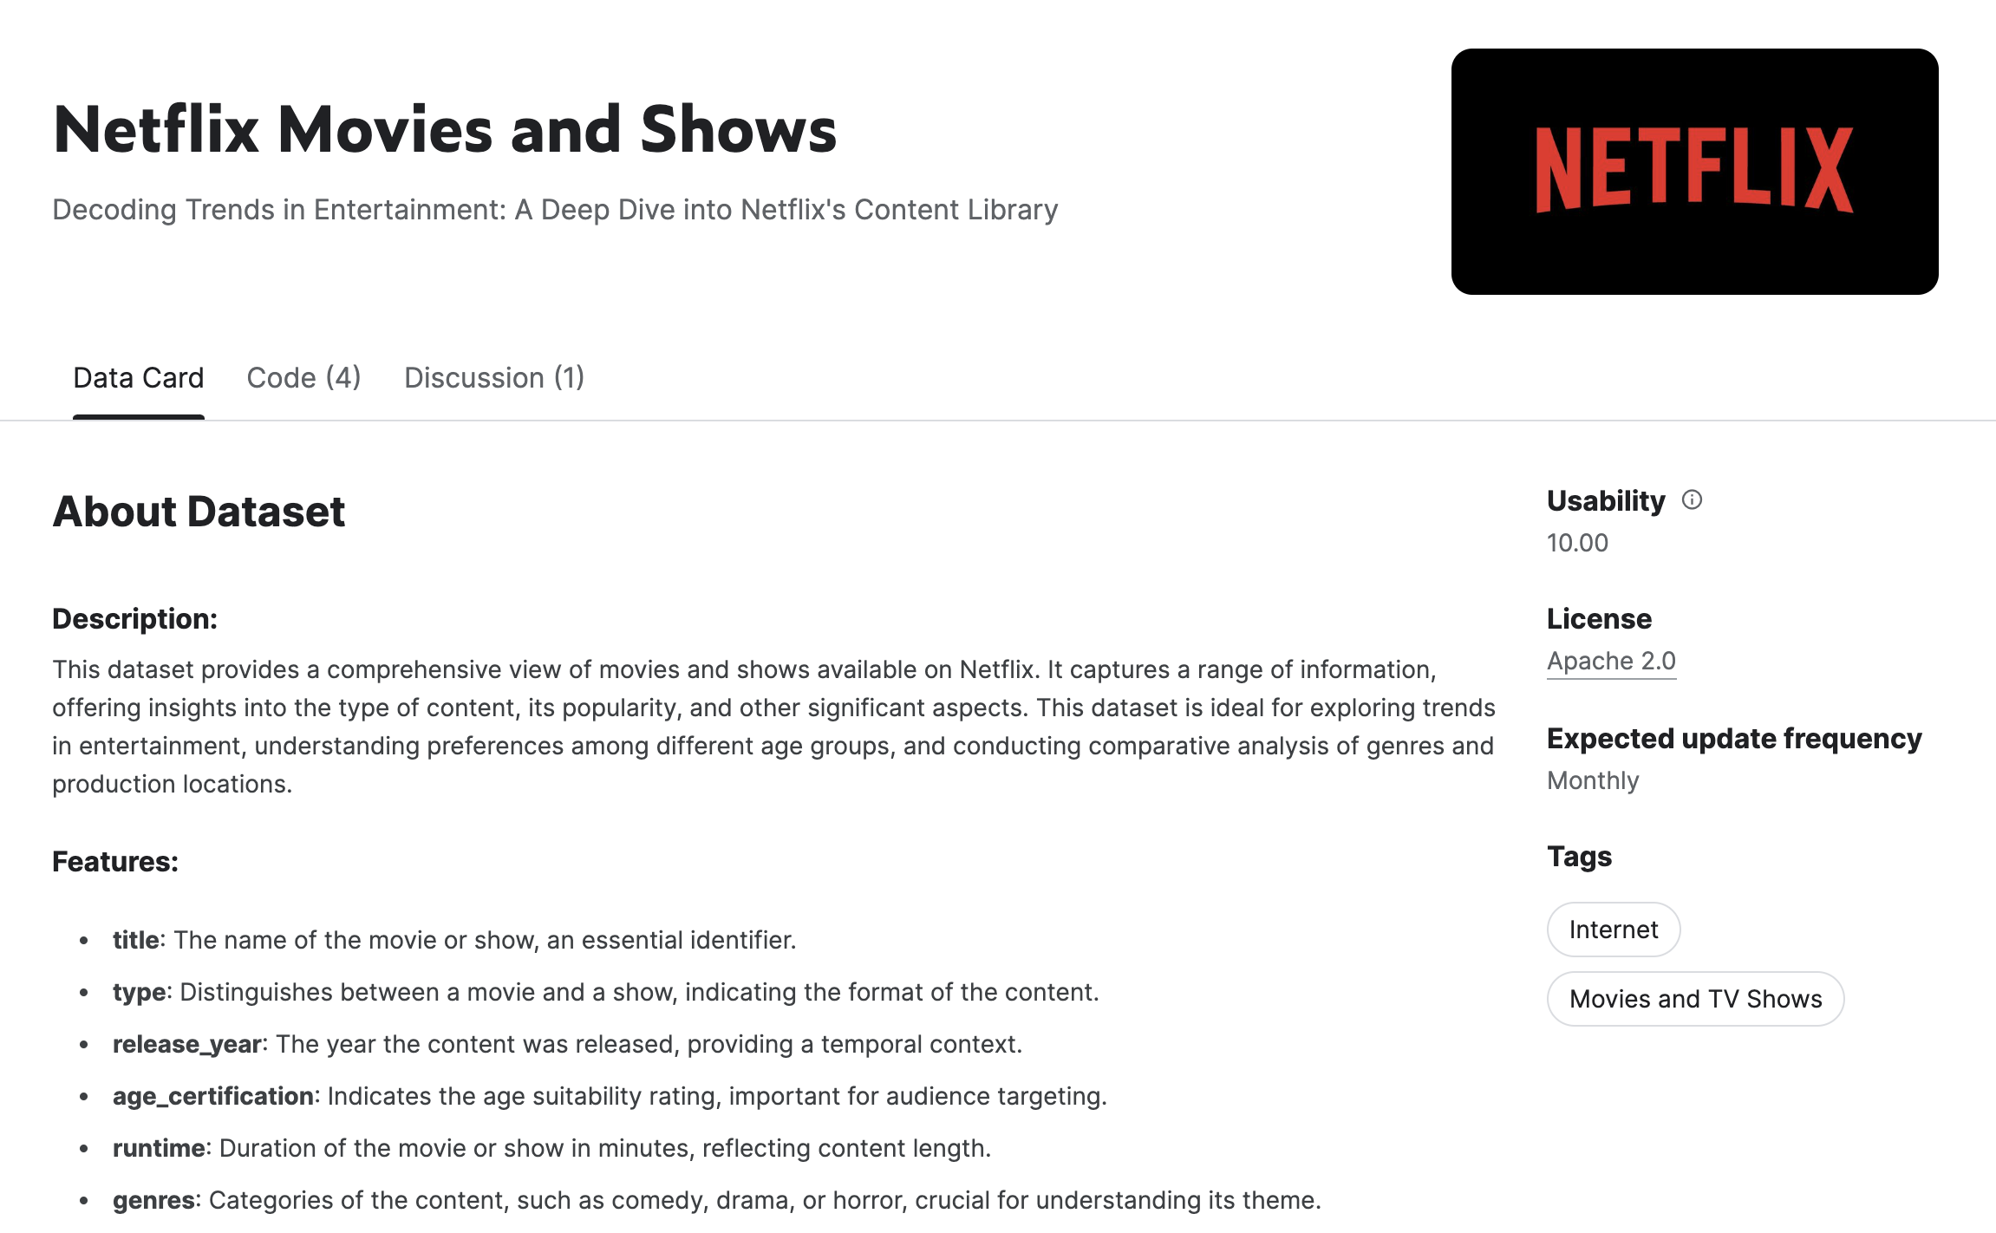
The Dataset

Slide 5
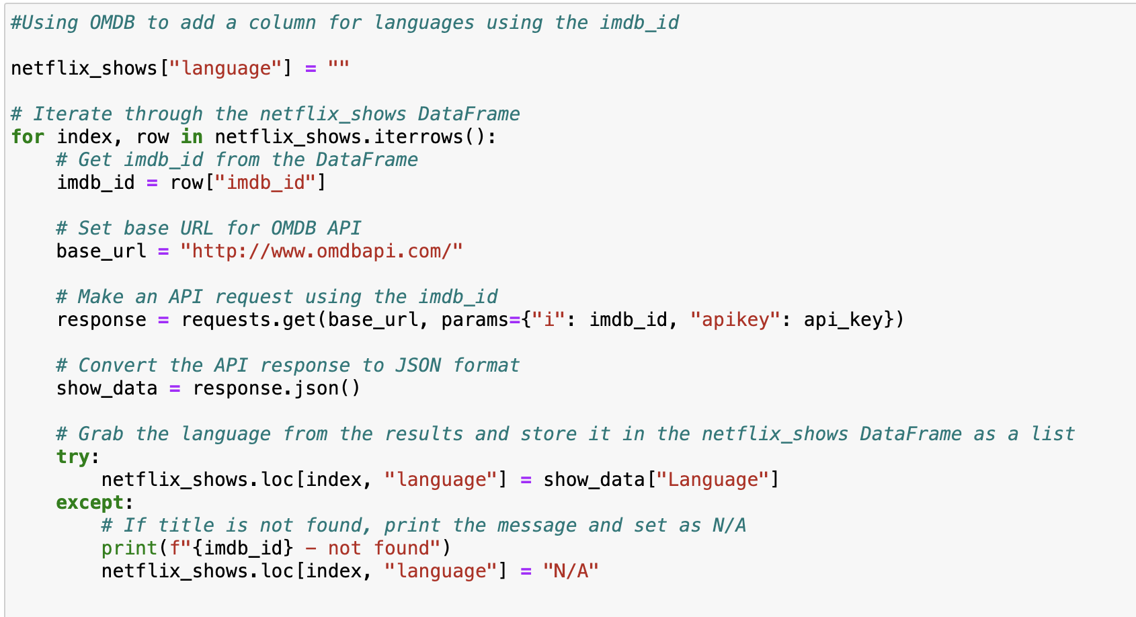
OMDB API to supplement the primary dataset

Slide 6
Research Questions
1
How has Netflix’s content strategy for TV shows evolved?
2
What are the factors that determine a show’s success/popularity?
3
Has there been a shift in target audience demographics?
4
Did the pandemic change tastes in favour of reality TV?

Slide 7
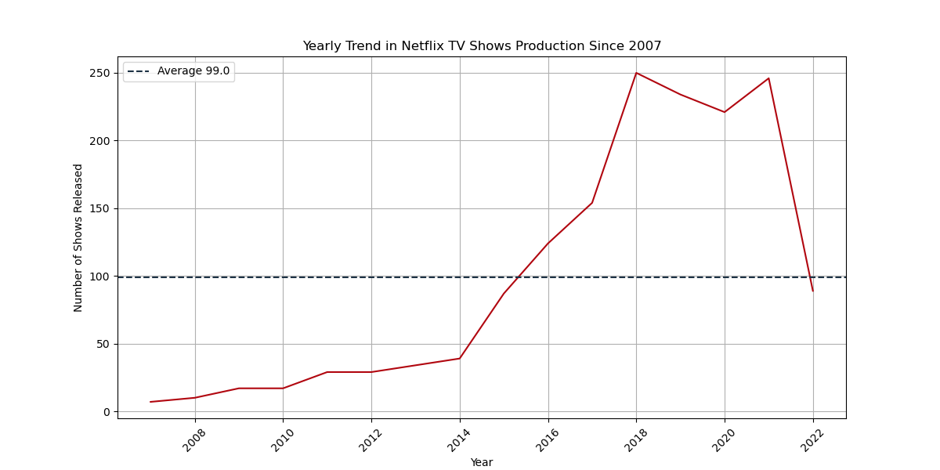

1
How has Netflix’s content strategy for TV shows evolved?
Notes:
Yearly Trend in Netflix TV Shows Production Since 2007: This line graph shows the number of TV shows released on Netflix per year from around 2007 to 2022. The graph indicates a general increase in the number of shows produced over time, with a peak around 2020 before a sharp decline. A dotted line shows the average number of shows released over this period.

Slide 8
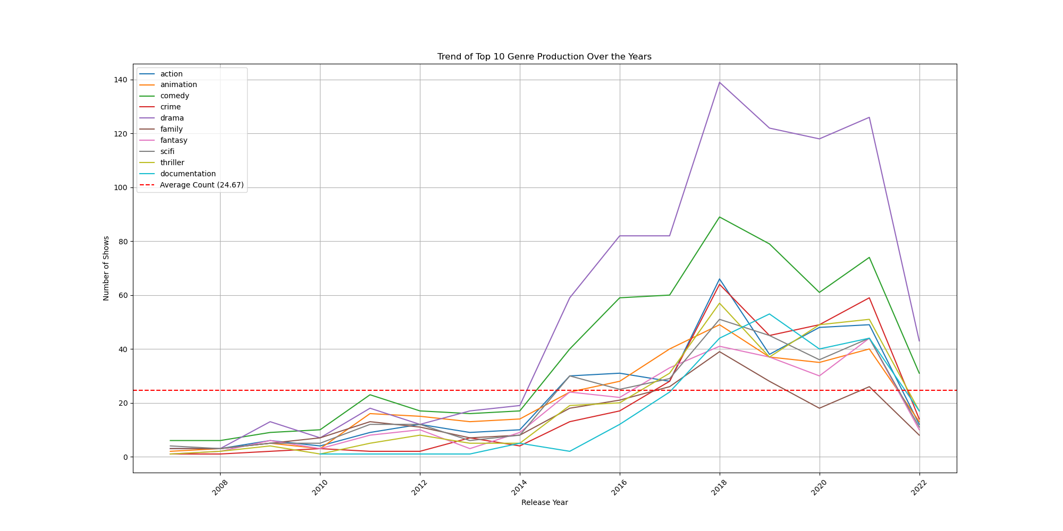
1
How has Netflix’s content strategy for TV shows evolved?
Notes:
Trend of Top 10 Genre Production Over the Years: This line graph illustrates the production trends of the top 10 TV show genres over the same timeframe. Each genre is represented by a different coloured line, and there is a dashed line indicating the average count of shows produced across these genres.

Slide 9
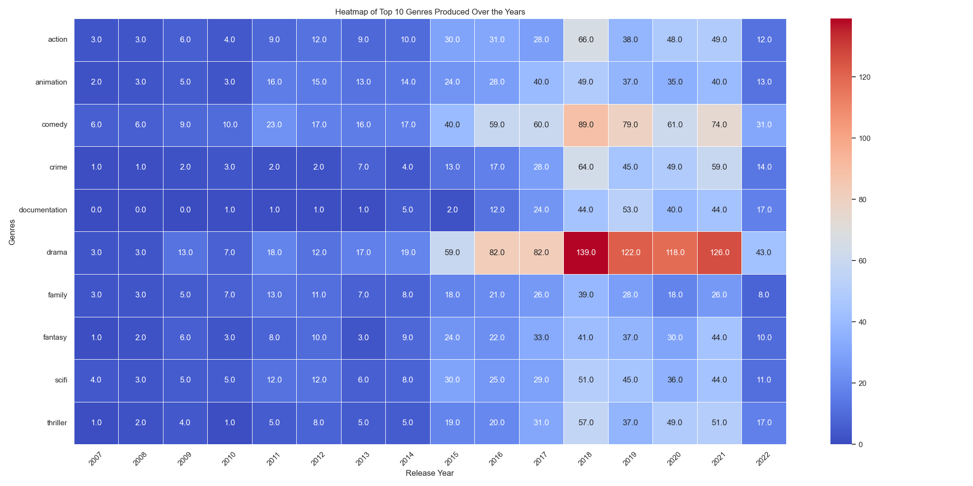
1
How has Netflix’s content strategy for TV shows evolved?
Notes:
Heatmap of Top 10 Genres Produced Over the Years: This heatmap visualizes the number of TV shows produced in the top 10 genres from 2007 to 2022. The intensity of the color correlates with the number of productions: the darker the color, the higher the number of shows. This type of visualization helps quickly identify which genres and years saw the most production.

Slide 10
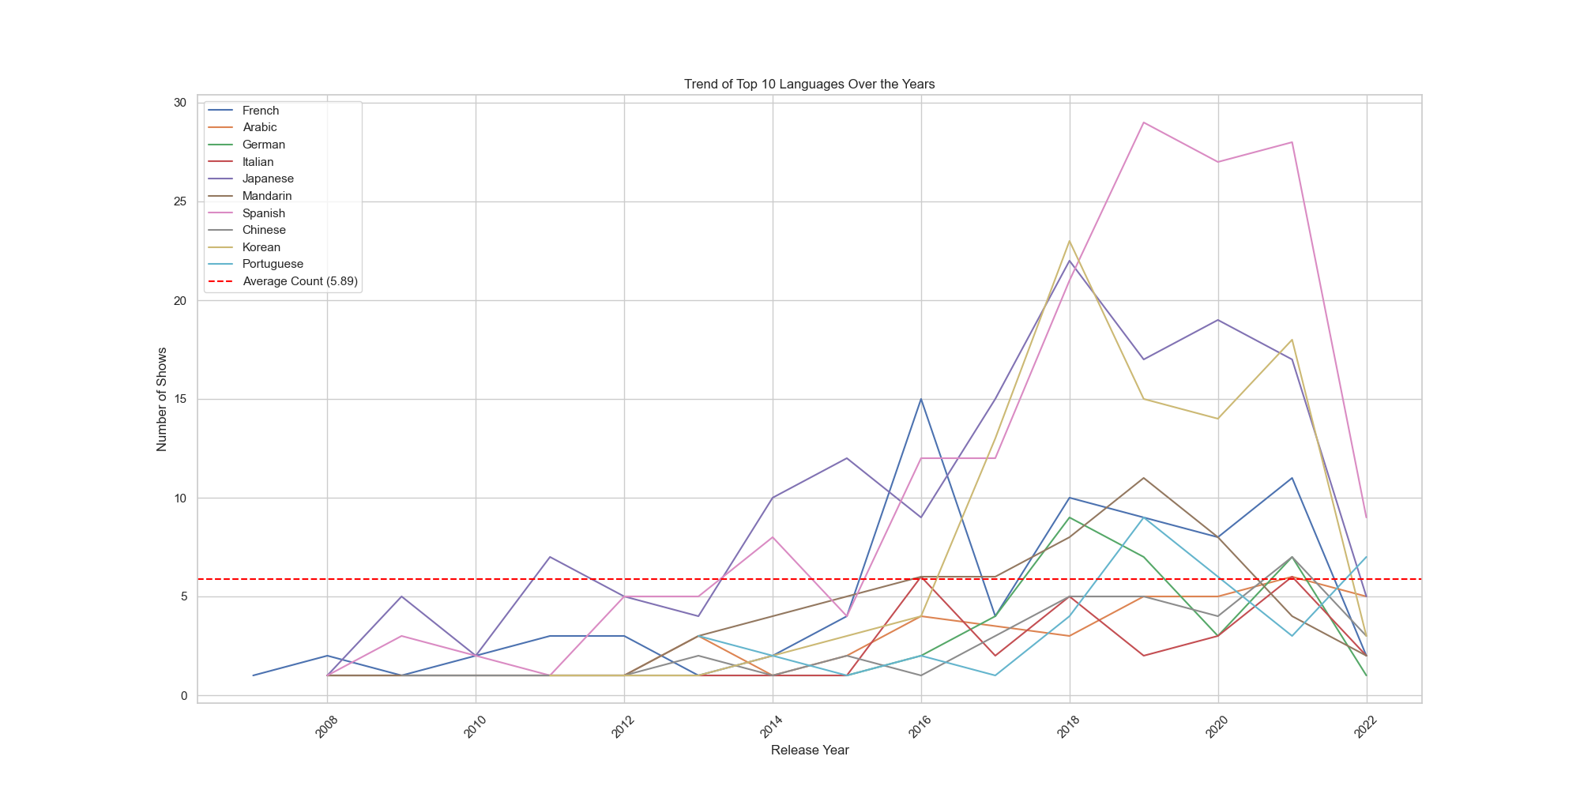
1
How has Netflix’s content strategy for TV shows evolved?

Slide 11
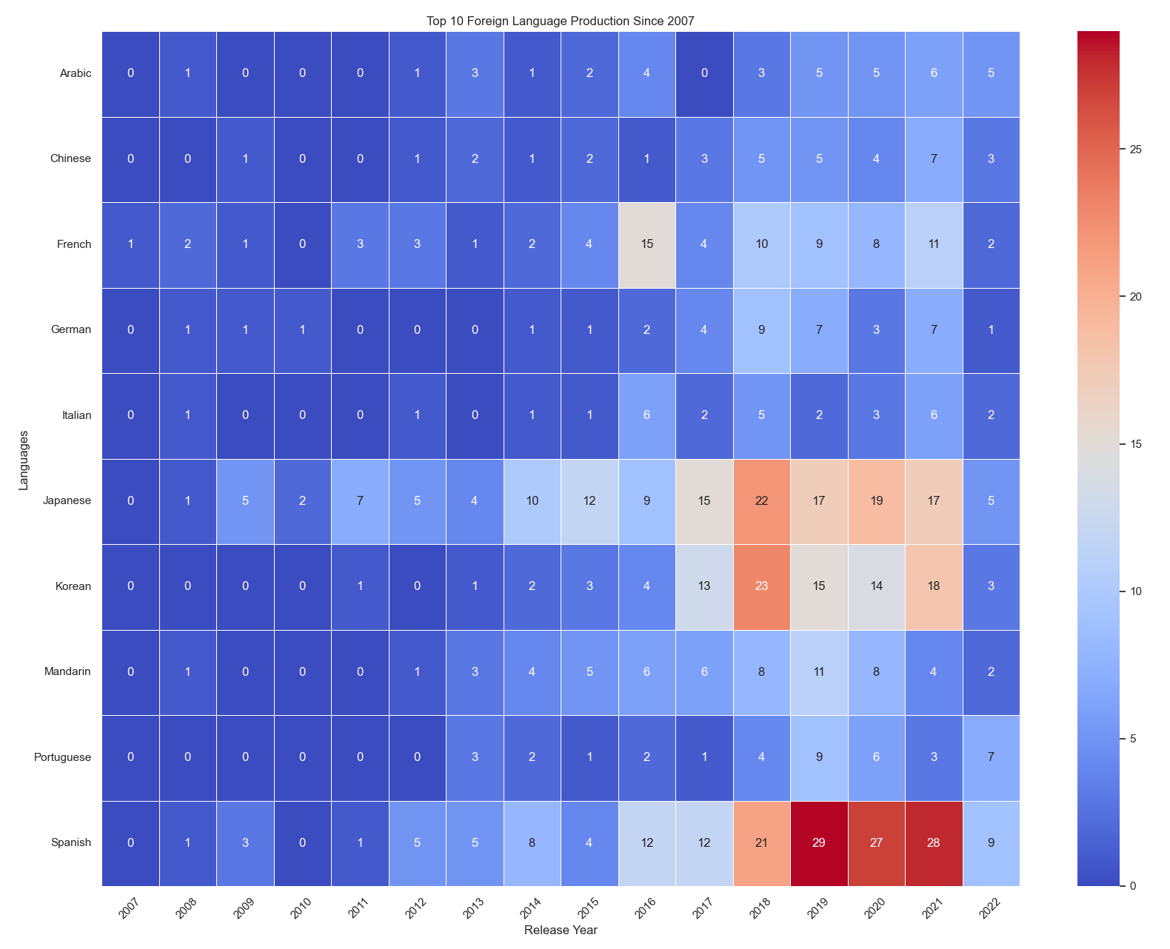
1
How has Netflix’s content strategy for TV shows evolved?
Notes:
There has been a significant increase in the production of TV shows on Netflix since 2007, with a notable peak around 2020.
Drama appears to be a consistently popular genre, with a substantial increase in production over time, especially in recent years.
The production of content in non-English languages has also been increasing, with a particularly noticeable growth in shows in Japanese, Korean, and Spanish, reflecting a diversification in Netflix's offerings.
The heatmaps provide a clear visualization of which genres and languages have been more prevalent over the years, with darker shades indicating higher numbers of productions.
There is a sharp decrease in both the production of TV shows across genres and languages in the last year shown on the graphs, which may indicate a shift in strategy, market conditions, or external factors affecting production.

Slide 12
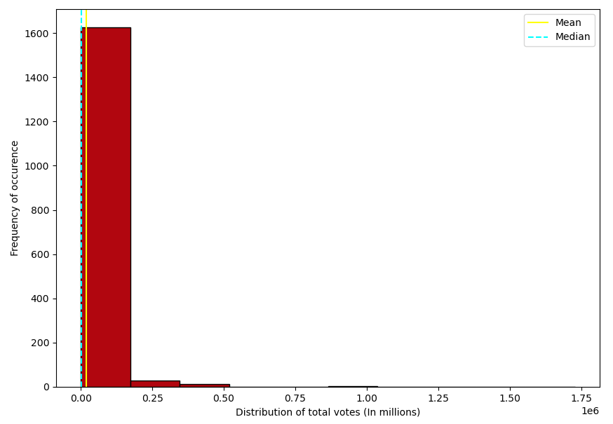
2
What are the factors that determine a show’s success/popularity?

Slide 13
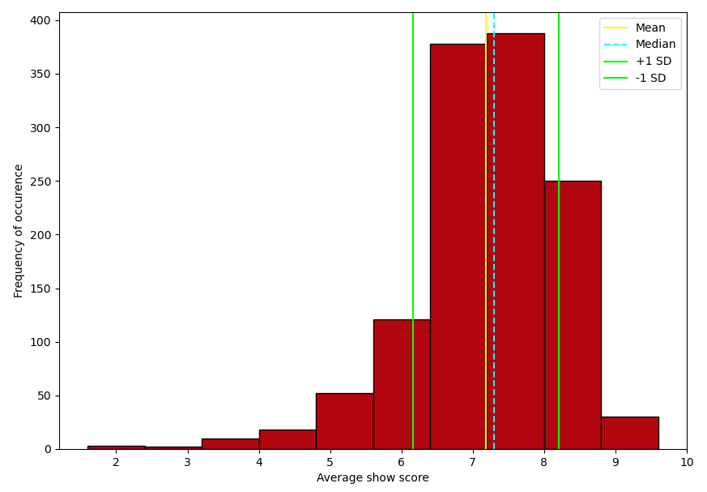
2
What are the factors that determine a show’s success/popularity?

Slide 14
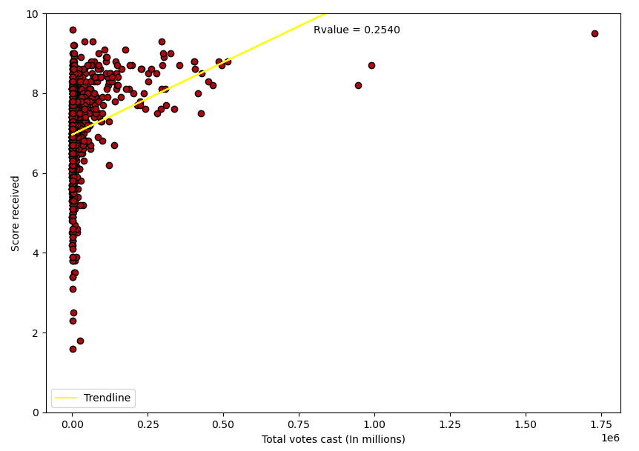
2
What are the factors that determine a show’s success/popularity?

Slide 15
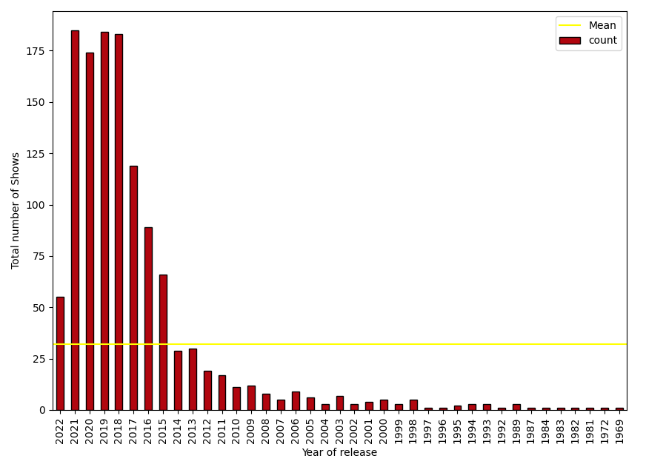
2
What are the factors that determine a show’s success/popularity?

Slide 16
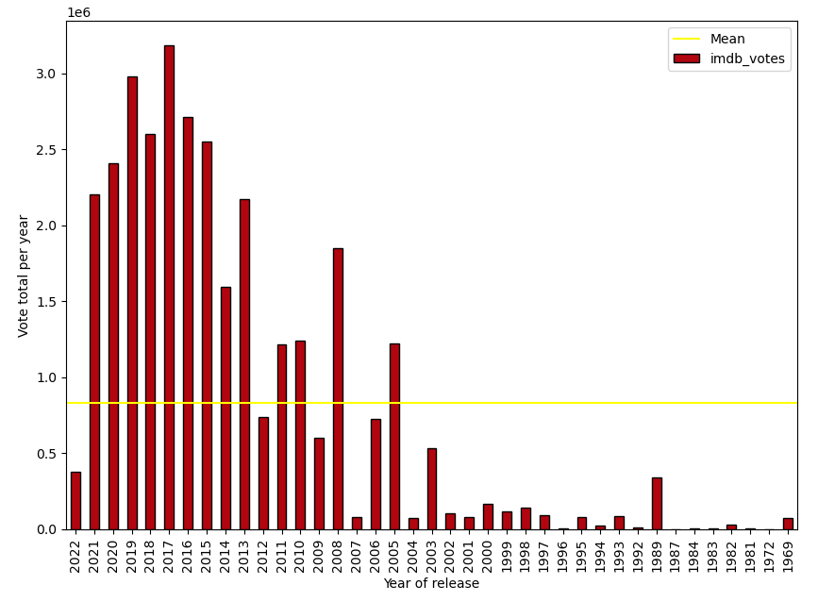
2
What are the factors that determine a show’s success/popularity?

Slide 17
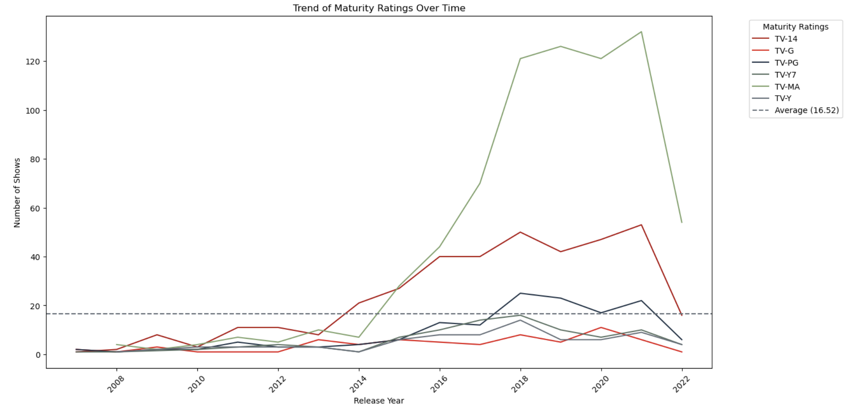
3
Has there been a shift in target audience demographics?

Slide 18
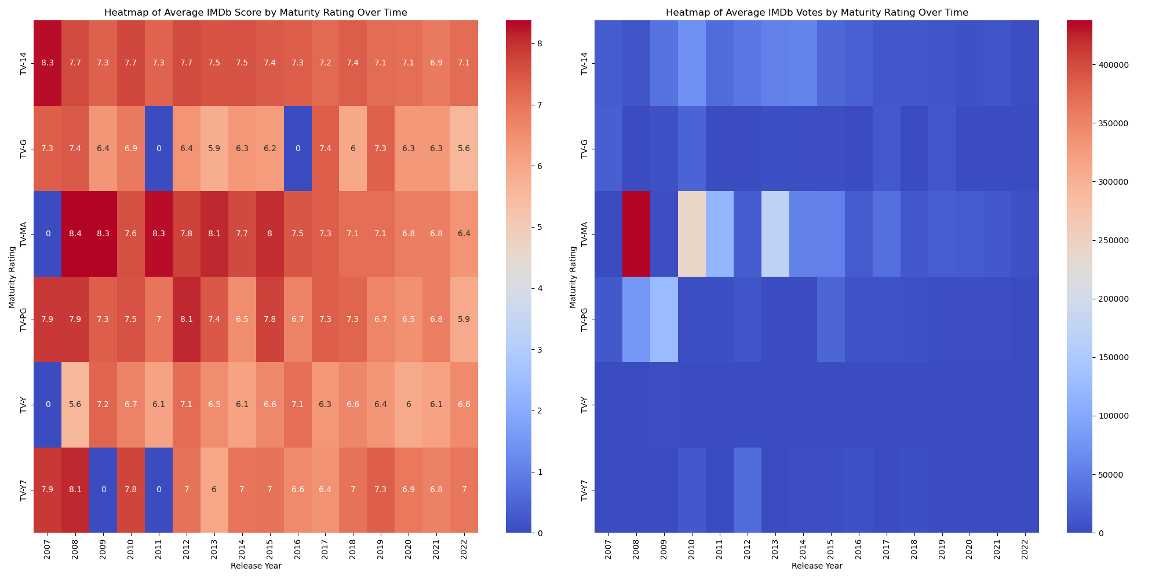
3
Has there been a shift in target audience demographics?

Slide 19
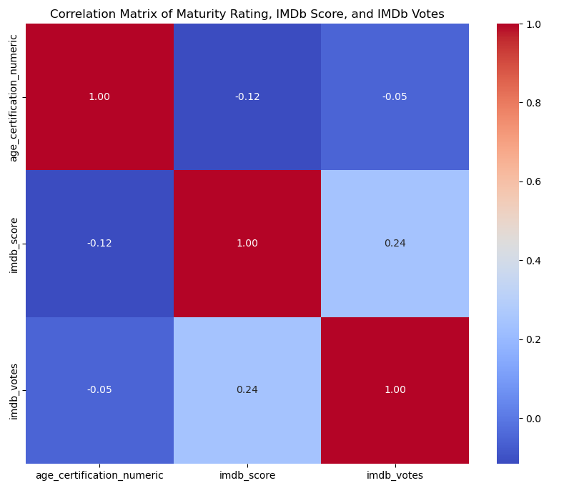
3
Has there been a shift in target audience demographics?

Slide 20
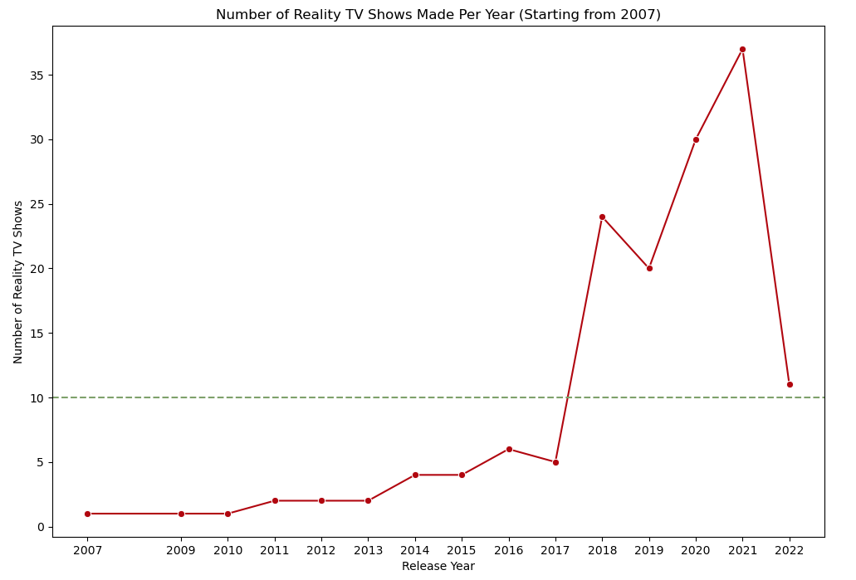
4
Did the pandemic change tastes in favour of reality TV?

Slide 21
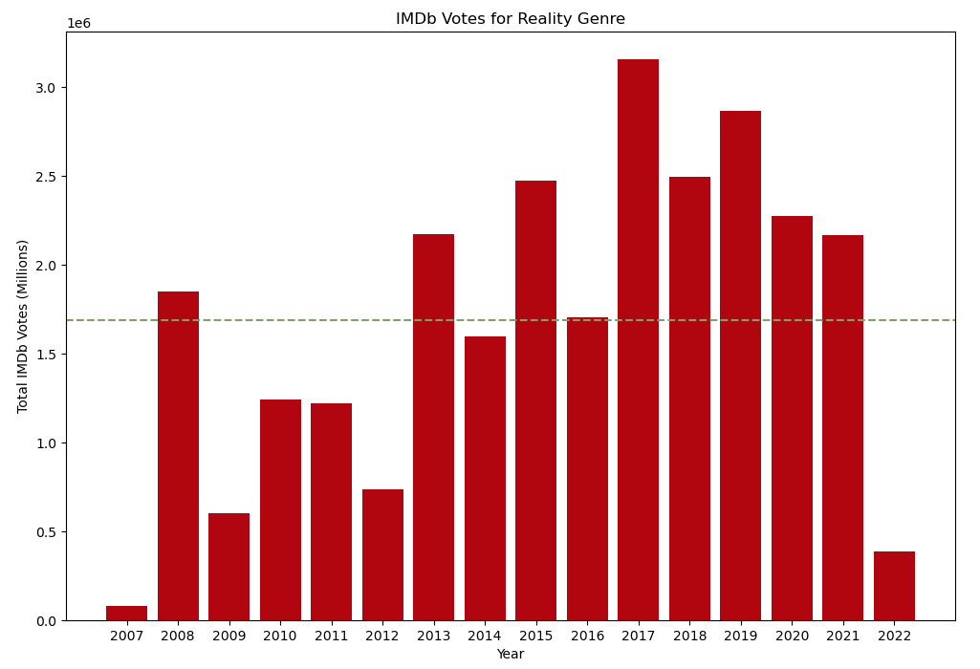
4
Did the pandemic change tastes in favour of reality TV?

Slide 22
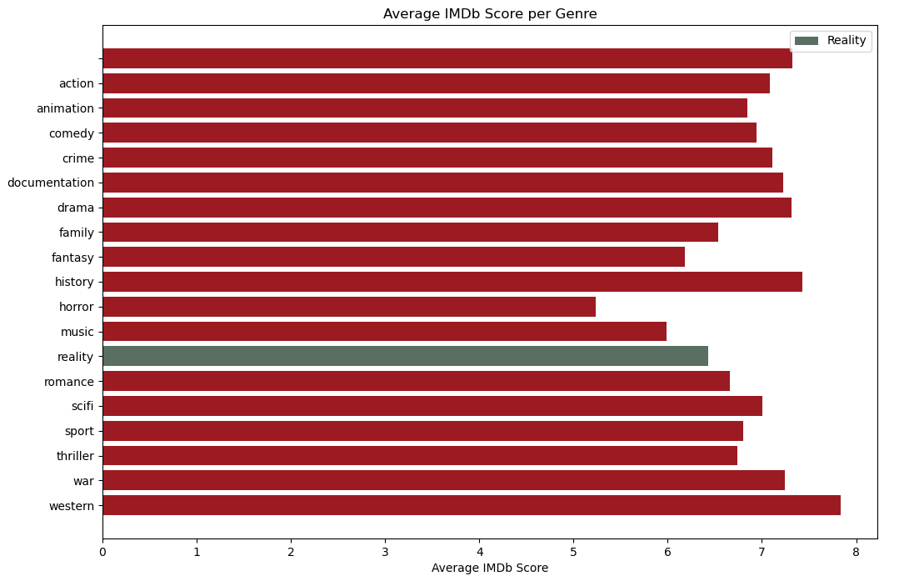
4
Did the pandemic change tastes in favour of reality TV?

Slide 23


